Slide 1
UIT1311 – Programming and Data Structures Lab Mini Project – 2021-2022 III SEMESTER IT – INSTANCE B Text Editor
205002038 – Harish A – Batch 1
205002051 – K Mughilan – Batch 2
205002301 – Akkash Anniyappa C S – Batch 2

Slide 2
IDEOLOGY
Using doubly linked list data structure to perform text editor operations by initializing head as the cursor “|”.

Slide 3
OPERATIONS
Inserting a character to the left of the cursor
Moving the cursor to the left
Moving the cursor to the right
Deleting the character to the right of the cursor
Saving the changes made to the dll into a ‘.txt’ file specified (or “*.txt” in default)
Opening the requested ‘.txt’ file and initializing it into the dll (or in default opens “*.txt”)
Printing the current contents of the dll
Displaying legend of the keys corresponding to the operations for better user interface

Slide 4
CHOICE OF DATA STRUCTURE
Doubly linked list data structure was used to implement the project proposed.
# Node of a doubly linked list
class Node:
def __init__(self, next=None, prev=None, data=None):
self.next = next # reference to next node in DLL
self.prev = prev # reference to previous node in DLL
self.data = data

Slide 5
DIAGRAMATIC REPRESENTATIONS

Slide 6
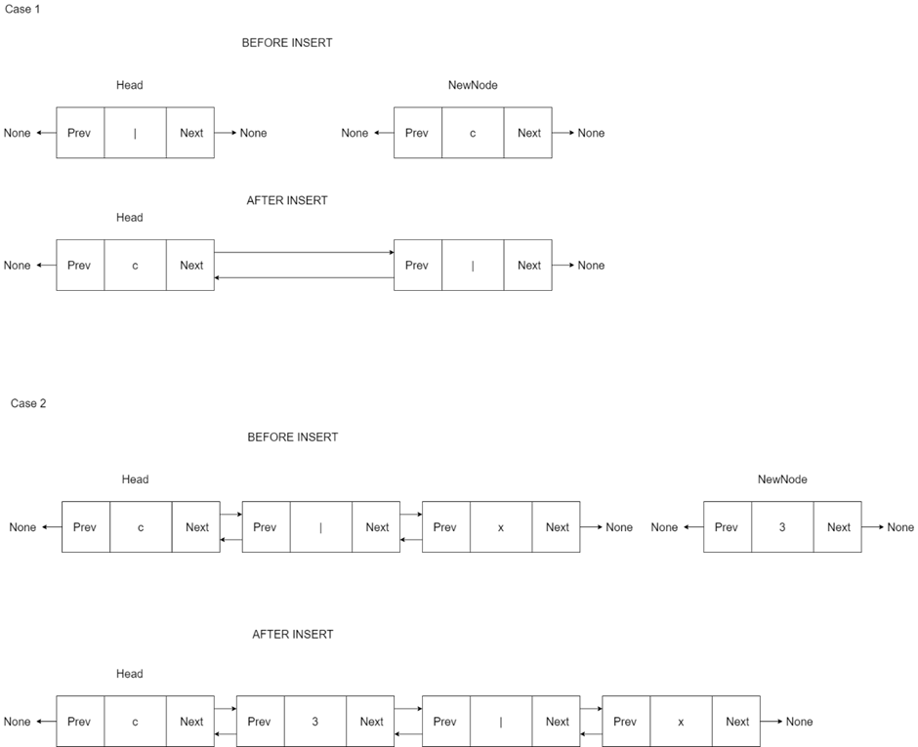
INSERT

Slide 7
INSERT

Slide 8
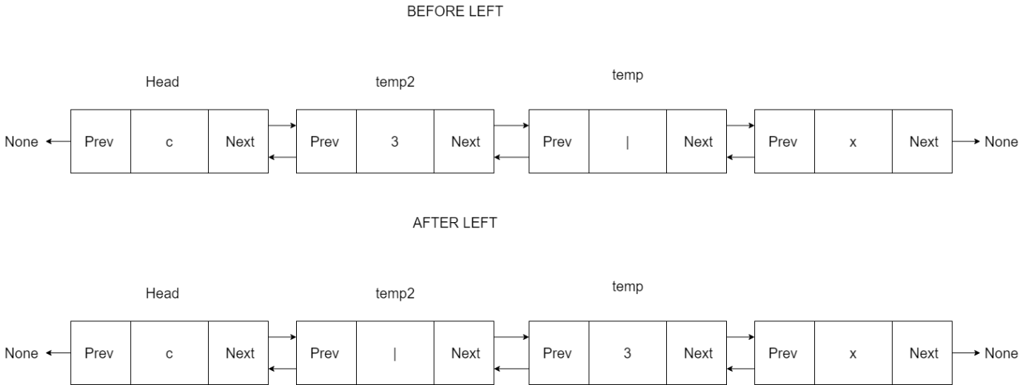
MOVING THE CURSOR TO THE LEFT

Slide 9
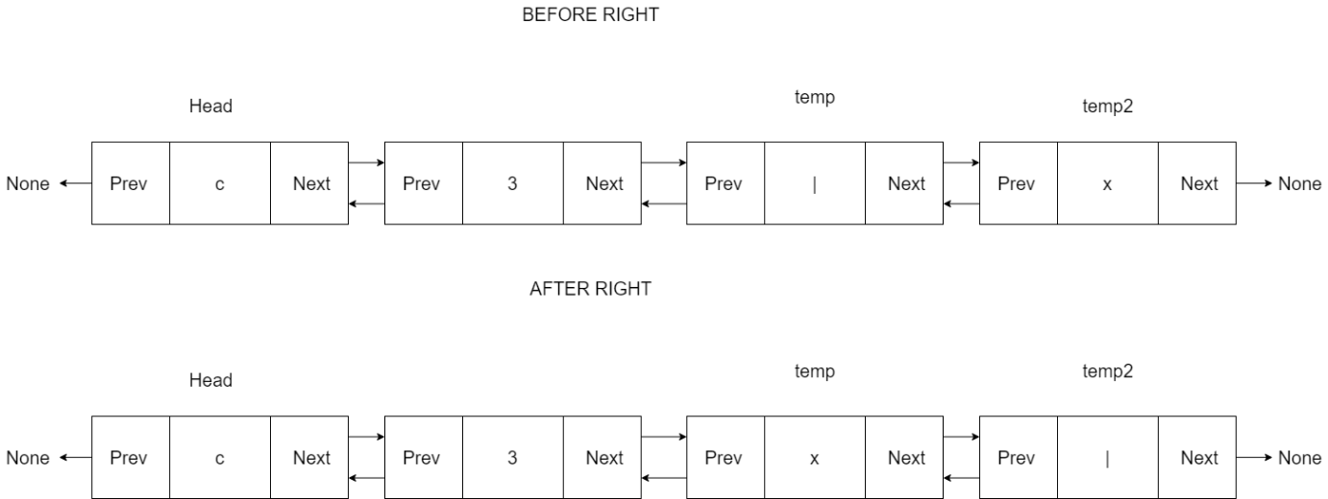
MOVING THE CURSOR TO THE RIGHT

Slide 10
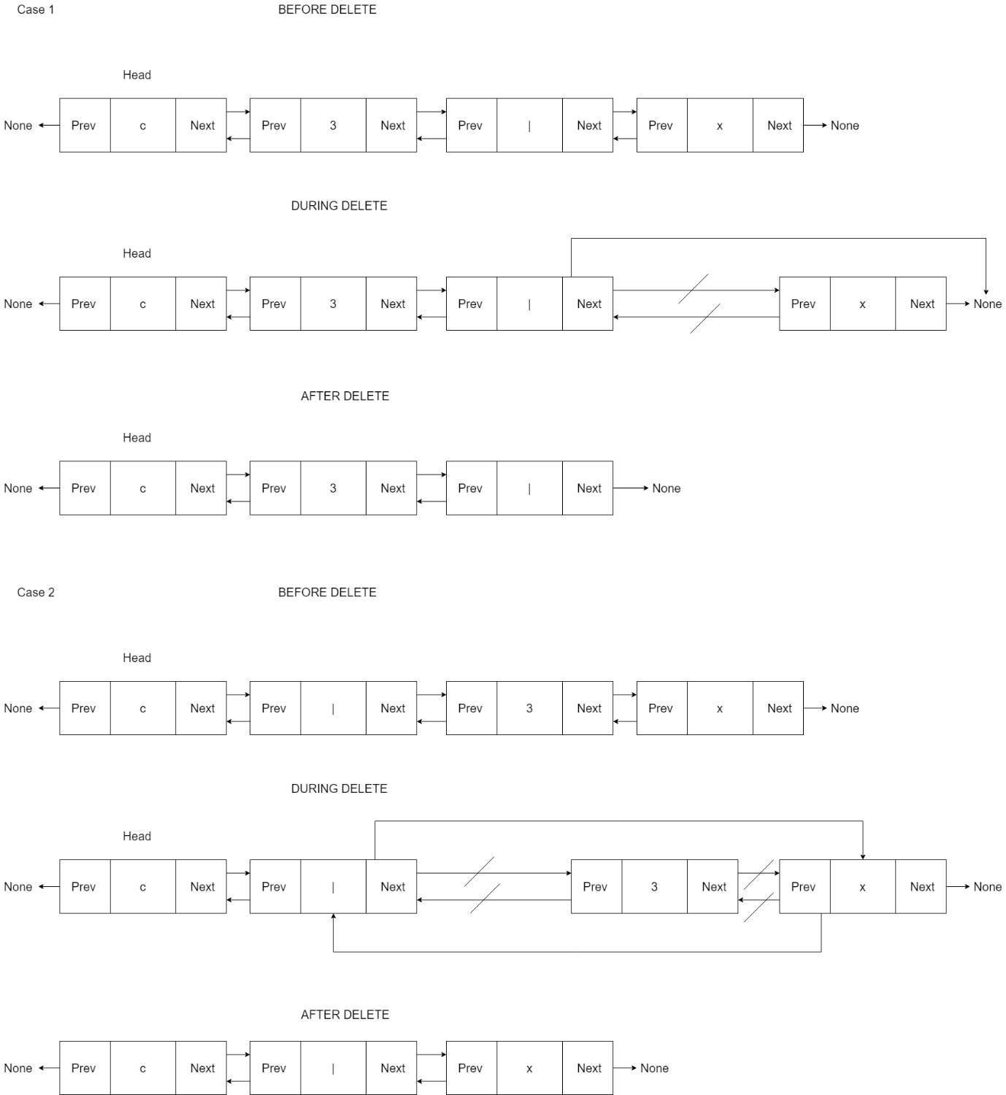
DELETING ENTRY TO THE RIGHT OF THE CURSOR

Slide 11
DELETING ENTRY TO THE RIGHT OF THE CURSOR

Slide 12
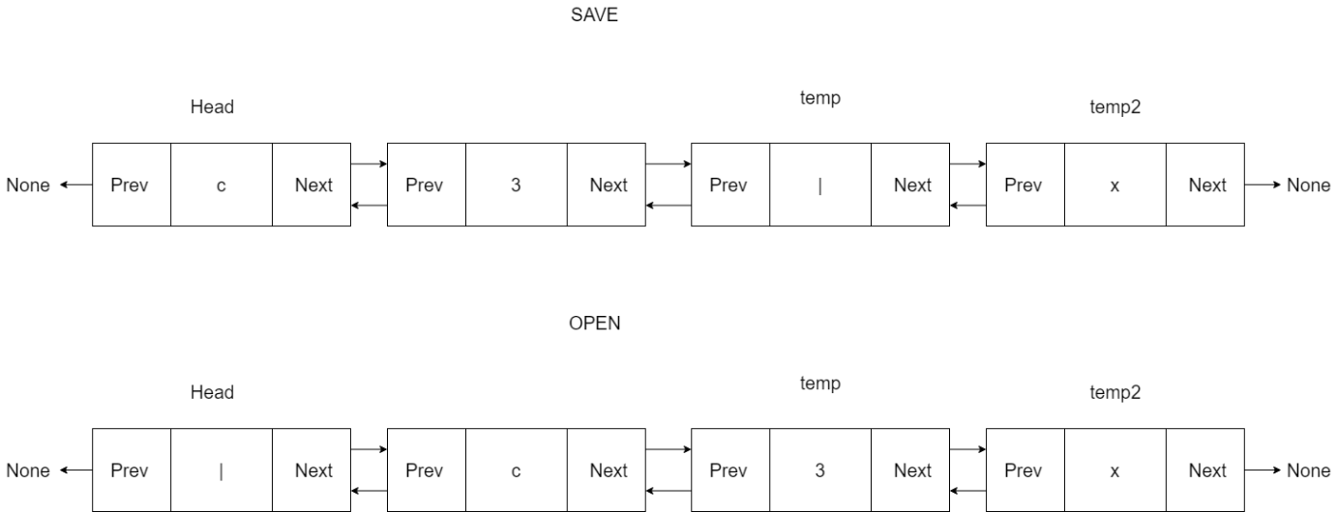
SAVING AND OPENING “.TXT” FILE

Slide 13
Complexity analysis
Method | Best Case | Average Case | Worst Case
insert | O(1) | O(n) | O(n)
delete | O(1) | O(n) | O(n)
left | O(1) | O(n) | O(n)
right | O(1) | O(n) | O(n)

Slide 14
conclusion
This project demonstrates the use of doubly linked list to create a text editor.
Doubly linked list data structure was used in the text editor ADT as it eases the operations of moving the cursor to its left and right
REASON FOR CHOOSING DOUBLY LINKED LIST

Slide 15
REFERENCES
https://stackabuse.com/doubly-linked-list-with-python-examples/
https://www.geeksforgeeks.org/doubly-linked-list/
https://www.w3schools.com/python/python_file_handling.asp
Michael T. Goodrich, Roberto Tamassia, and Michael H. Goldwasser, “Data Structures & Algorithms in Python”, John Wiley & Sons Inc., 2013

Slide 16
THANK YOU

